Slide 1
Assisting people with disability in using ATMs across the country
Analysing banks as an area for improvement
~ Presented by Kaizen

Slide 2

Our Team -
Sneha Kumari : 20IM30020
Deepa Raj : 20IM10006
Manav Israni : 20IM10019
Sanjana Singh : 20IM30018
Jir Et Katharpi : 20IM10015

Slide 3
Project timing
Making desired changes for better results in the software implemented.
Beginning with preliminary ideas as solutions.
Phase 2
Phase 4
Phase 1
Phase 3
Comprehending the problem statement.
Working on solutions proposed in the form of software implementation.

Slide 4
Table of contents
01
02
03
04
Problem statement
Motive
Solutions Proposed
Future vision
To make everyday tasks like using an ATM easier for people with disabilities and improve their quality of life.
To reduce dependence of the PWDs on others.
Face, Gesture and Voice recognition Models and few changes to be inculcated from the bank’s side.
Overview of the difficulties faced by persons with disability in using ATMs across the country

Slide 5
Introduction
Using ATMs is a herculean task for people with visual impairment, people with dyslexia and people on wheelchair. We have worked towards the idea of alleviating the problems faced by them and making ATMs accessible to all through a slew of software and hardware tweaks.

Slide 6
01
Problem
Statement

Slide 7
In today’s date :
2.1%
50
out of the 1.04 lakh ATMs in India are accessible to people with disabilities.
Of Indian population has some form of physical disability.

Slide 8
The current banking scenario in India
ATMs are presently, inoperable by people with visual impairment and to some extent, for people on wheelchair as well.
Such people need to be accompanied by someone to carry out a transaction.
ATMs are also very hard to operate for the people with dyslexia due to various constraints.
The above bullets are just a few of a near-infinite problems faced by PWDs.

Slide 9
SWOT analysis
Strengths
S
W
Weaknesses
Processing the largest transaction volumes in the world, Indian ATMs are faster and more efficient than the ATMS in many first-world countries.
Inaccessible to people with physical disabilities and people with dyslexia
Opportunities
O
T
Making ATMs accessible to PWD
Threats
Reduction in the use of ATMs for cash-withdrawal with the introduction and rapid adoption of digital payment methods like UPI.

Slide 10
Solutions Proposed :
Adding Facial Recognition/ Fingerprint:
Voice Based Assistance :
Hardware Tweaks :
Using Gesture Recognition:
Adding voice based instructions to aid the visually impared and people with dyslexia while using ATM.
Facial /Fingerprint Recognition models can be implemented in integration to PIN for cash withdrawal.
Using gesture recognition model to ease the use of ATM for the physically challenged.
Hardware tweaks like adding a secondary keyboard at a lower height to make the ATM booth wheelchair friendly.

Slide 11
Proposed solution that requires major involvement of authorities and banks :
Before getting into solution part, we need to comprehend how the current ATMs work -
ATM Cards are linked to our bank accounts. Whenever we use the card at ATMs or for online/offline transactions, money is debited from our linked bank account. For withdrawing cash at ATMs and offline transactions, one requires to enter his/her 4-digit ATM PIN.

Slide 12
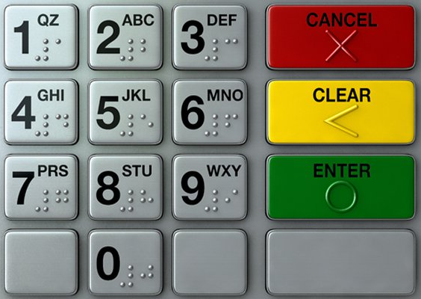
When you insert your debit or credit card into the ATM, it reads the information encoded on the magnetic strip on the back of the card. That black strip is encoded with your unique card number, expiration date and personal identification number (PIN).
The ATM then asks for your PIN to verify your authorization to access account funds and information. When you have verified your PIN, the ATM communicates with your bank to access your account information. It can then display your account balance or distribute cash to you from your bank account balance.

Slide 13
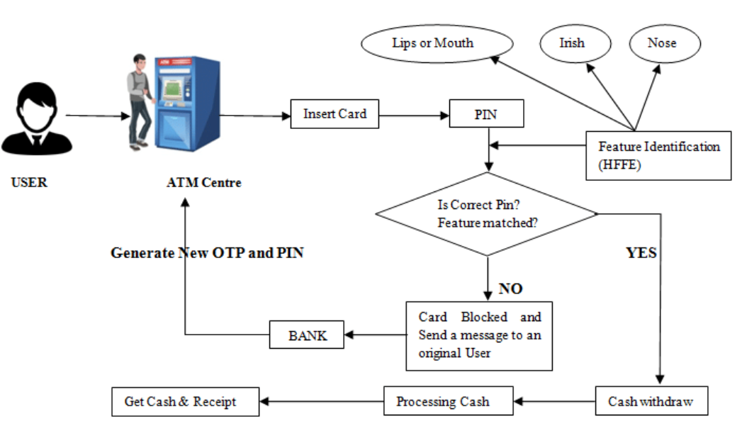
ATM Block Diagram

Slide 14
Now coming to the solutions proposed :
Using modified ATM cards-
Issuing of special debit cards by the banks which would contain the information about the person’s disability.
This information will be collected by the bank at the time of issuing the card and will be linked to the account holder’s account number or the debit card number.
This will help in enabling specialized features of the ATM machine for the specially-abled people. For example : voice based assistance for people with visual impairment.

Slide 15
2. Informing about Non-functional ATM machines -
Several times the ATM machines are out of order , which causes inconvenience to the people with diabilities as travelling to the ATM booth over and over becomes troublesome for them.
To counter this, each bank can send a text message to its customers who live nearby the non-functional ATM, just like we get a message after every withdrawal.
An app provided by the bank, in the form of service can be rendered, which would show the functional status of the ATM within a certain radii of area.

Slide 16

3. ATMs - Trouble for people with Dyslexia
The prevalence of dyslexia is estimated to be between 5% and 17% of school-age children in India and nearly 35 million children in the country are thought to have this learning disability; Most of them can't spell out alphabets.
ATMs for a long time have been not-so-helpful to such people.
Majority of ATMs only have Hindi or English as system options .
For this we can incorporate all the major spoken local languages all over
India in the ATM network.
Selection of language may vary from region to region,
depending upon the major-spoken language of that
particular area.
Plus to finalize the transaction, fingerprint can be used as
they are already in use for government documents like
aadhar cards.

Slide 17
Business model:
Marketing
Technology
Surge in need for automation in the banking sector in emerging as well as developed countries is driving the ATM market growth.
Global banking sector has witnessed several technological advancements in the form of integration of IoT data analysis, digital convergence, biometrics and cyber security, which fuel the market growth.
Rise in digitization is attributed to increase in preference of consumers towards digital payment methods such as online banking, digital wallets and bitcoin transactions. This is expected to adversely affect the ATM market revenue in the coming years.
Deep Learning and computer vision models of face recognition and
hand gesture recognition features have been made.
https://www.alliedmarketresearch.com/automated-teller-machine-ATM-market

Slide 18
Progress Made on solutions proposed:

Slide 19
Working on software implementation of facial recognition and voice-based assistance to aid the physically challenged and illiterate people.
Study on-
working of the ATM card, i.e, how it feeds the information to the machine which in turn carries out the transaction on behalf of the user’s bank.
various features implemented in the ATM machines currently prevalent in developed countries.
Hardware renders of ATM machine have been created and are
being modified.

Slide 20
Writing and implementation of codes for
a.) Face detection model (week3)
b.) Face recognition model (week 4)
Commencing with face detection feature which was a preliminary idea, we further progressed it into ‘face recognition’ feature, helpful for people with visual impairment.
Apart from just ATM machines, it can also be implemented in other fields of public access for the people with visual impairment and physical disabilities who are not able to use fingerprint access or any other means.

Slide 21
SOFTWARE
IMPLEMENTATION:

Slide 22
Using Computer Vision For Face Detection-
CODE:-
import numpy as np
from cv2 import cv2 as cv2
from PIL import Image
def rescaleframe(frame1):
dimenstions=(2000,1200)
return cv2.resize(frame1,dimenstions,interpolation=cv2.INTER_AREA)
captue=cv2.VideoCapture(0)
while True:
ret,xyg=captue.read()

Slide 23
Code for face detection →
#blank=np.zeros(xyg.shape[:2],dtype='uint8')
xyg=cv2.cvtColor(xyg,cv2.COLOR_BGR2GRAY)
xyg=cv2.flip(xyg,1)
xyg=rescaleframe(xyg)
haar_cascade=cv2.CascadeClassifier('haar_face2.xml')
faces_rect=haar_cascade.detectMultiScale(xyg,1.1,4)
for(x,y,w,h) in faces_rect:

Slide 24
Code for face detection →
radius=((x+2*w+200)//2),(((y+h)//2)+65)
cv2.circle(xyg,radius,((w+h)//4),(0,255,0),2)
#blank=cv2.circle(blank,radius,((w+h)//4)+10,(0,255,0),2)
#jcole=cv2.bitwise_and(xyg,xyg, mask=blank)
cv2.imshow('face',xyg)
if(cv2.waitKey(1) & 0xFF==ord('d')):
break
captue.release()
cv2.destroyAllWindows()

Slide 25
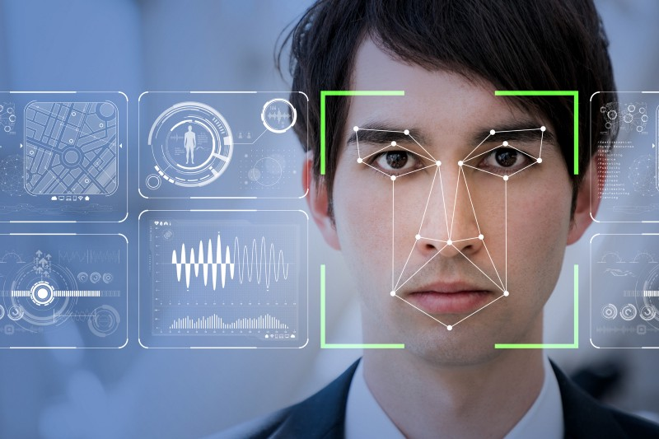
Code for ‘Face Recognition’ feature ->
import tensorflow as tf
from keras.preprocessing import image
from _future_ import print_function
import click
import os
import re
import face_recognition.api as face_recognition
import multiprocessing
import sys
import itertools
def print_result(filename, location):
top, right, bottom, left = location
print("{},{},{},{},{}".format(filename, top, right, bottom, left))
def test_image(image_to_check, model, upsample):
unknown_image = face_recognition.load_image_file(image_to_check)
face_locations = face_recognition.face_locations(unknown_image, number_of_times_to_upsample=upsample, model=model)

Slide 26
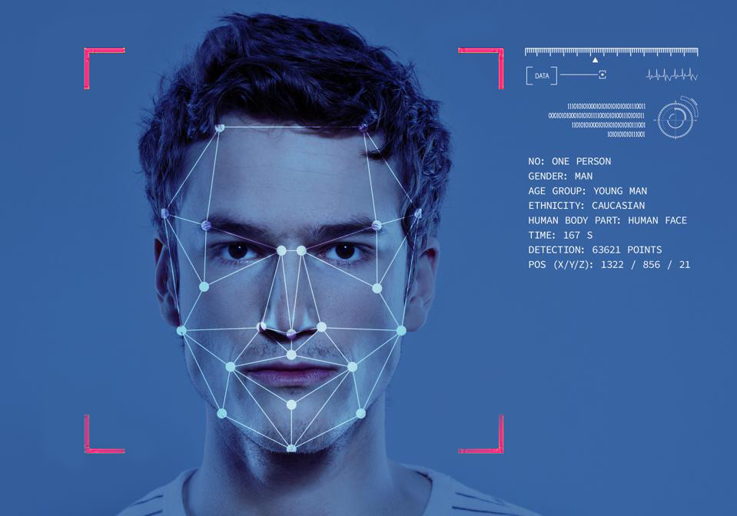
for face_location in face_locations:
print_result(image_to_check, face_location)
def image_files_in_folder(folder):
return [os.path.join(folder, f) for f in os.listdir(folder) if re.match(r'.*\.(jpg|jpeg|png)', f, flags=re.I)]
def process_images_in_process_pool(images_to_check, number_of_cpus, model, upsample):
if number_of_cpus == -1:
processes = None
else:
processes = number_of_cpus
context = multiprocessing
if "forkserver" in multiprocessing.get_all_start_methods():
context = multiprocessing.get_context("forkserver")
pool = context.Pool(processes=processes)
function_parameters = zip(
images_to_check,
itertools.repeat(model),
itertools.repeat(upsample),
)

Slide 27
pool.starmap(test_image, function_parameters)
@click.command()
@click.argument('image_to_check')
@click.option('--cpus', default=1, help='number of CPU cores to use in parallel. -1 means "use all in system"')
@click.option('--model', default="hog", help='Which face detection model to use. Options are "hog" or "cnn".')
@click.option('--upsample', default=0, help='How many times to upsample the image looking for faces. Higher numbers find smaller faces.')
def main(image_to_check, cpus, model, upsample):
# Multi-core processing only supported on Python 3.4 or greater
if (sys.version_info < (3, 4)) and cpus != 1:
click.echo("WARNING: Multi-processing support requires Python 3.4 or greater. Falling back to single-threaded processing!")
cpus = 1
if os.path.isdir(image_to_check):
if cpus == 1:
[test_image(image_file, model, upsample) for image_file in image_files_in_folder(image_to_check)]
else:
process_images_in_process_pool(image_files_in_folder(image_to_check), cpus, model, upsample)
else:
test_image(image_to_check, model, upsample)
if _name_ == "_main_":
main(

Slide 28
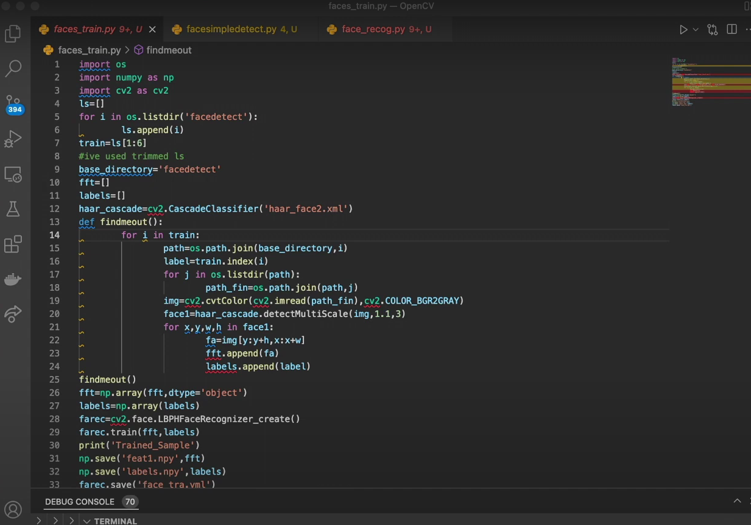
Demonstration of ‘face recognition’ code :

Slide 29
Hand Gesture Recognition Model:

Slide 30
The model has been trained for 15 epochs.
Four different gestures included as of now and will be increased in future.
Used a transfer learning for easy training on small training data.
Use of 400 training images to fine tune the model on them.
Each gesture class had 100 images each.
The training accuracy was around 97 %.

Slide 31
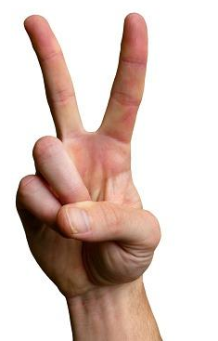
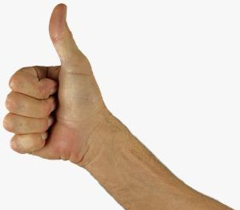
Four gestures included in our model :
2.
11.
Balance Check
Pin Change

Slide 32
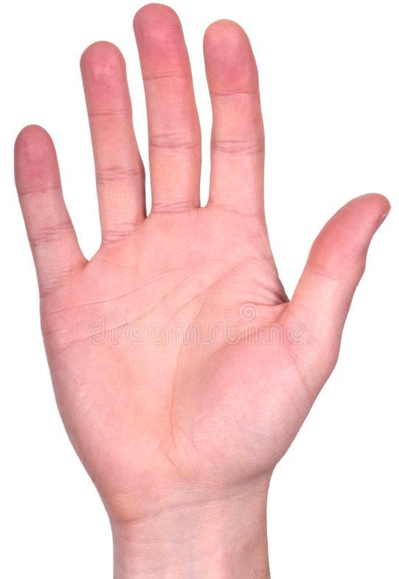

Four gestures included in our model :
3.
4.
Cardless Cash Withdrawal
Normal Cash Withdrawal

Slide 33
Code for Hand Gesture Recognition Model :
Link to the complete code:
https://colab.research.google.com/drive/1lEiDPePokkpBqaCtu89Eji3xxU8drKhp?usp=sharing
#Class 0 - Cash Withdrawal - Palm
#Class 1 - Balance Check - Thumbs-Up
#Class 2 - Pin change - Victory Sign
#Class 3 - Cardless Cash Withdrawal -Index and Thumb

Slide 34
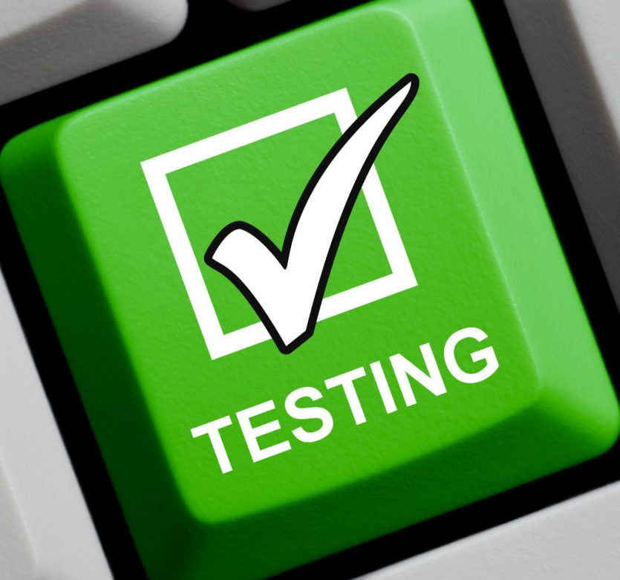
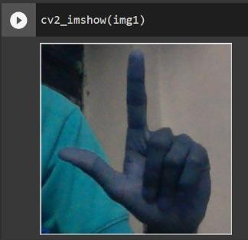
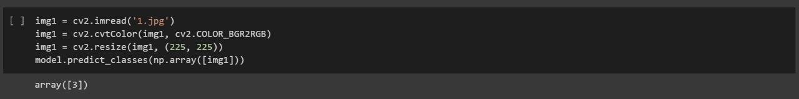
Testing the model :
1.
Image belonging to class 3 (cardless withdrawal)
Class prediction

Slide 35
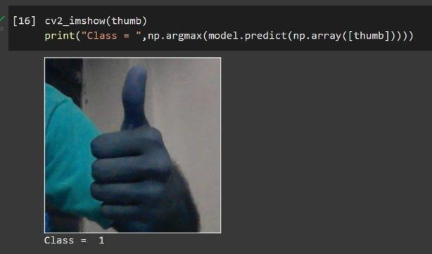
Testing the model :
2.
Model correctly classified the test images in a number of cases.

Slide 36

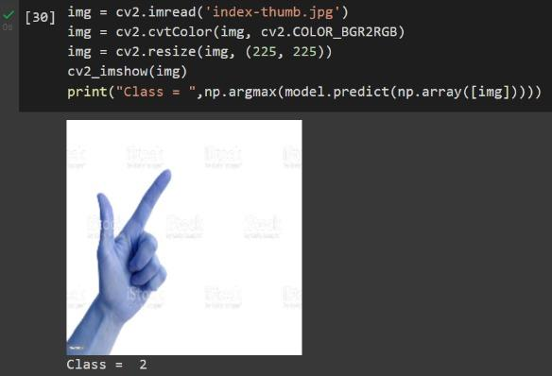
An incorrect prediction by the model:
Clearly for the image beside, the model yields an incorrect prediction of it being a victory sign.
Here, instead of index and middle fingers, index and thumb fingers have been shown still the model predicts it as class 2.

Slide 37
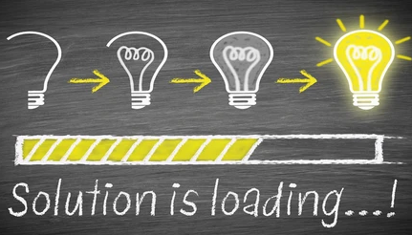
Further improvements that can be inculcated in our model:
1. Model is slightly overfitting due to lesser number of training images.To overcome it, we can increase the size of the training dataset.
2. Image Augmentation is to be included to account for various orientations of gestures.
3. A deeper CNN is to be designed.

Slide 38
Some of the improvements included for better implementation and increasing accuracy (final week progress):
1. Training size has been increased from 400 images to 1200 images.
2. Overfitting has been reduced and validation accuracy has been increased to 90%.
3. Image augmentation has been introduced by rotating and flipping the image.
An integration of the hand gesture recognition model and face recognition model can thus be employed.

Slide 39
Acknowledgement
We, as a group, would like to sincerely express our gratitude to Prof. Manjira Sinha for giving us the golden opportunity to work on this project, which helped us a lot in enriching our knowledge and expanding our thought processes.
Because of this research, we've been more diligent in our pursuit of improved answers to the challenges encountered by persons with disabilities.

Slide 40

Thank you
Presented by - Group Kaizen

